Slide 1
Welcome to
Math & Logic!

Slide 2
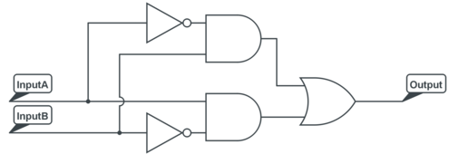
Review: What did we do in class last time?
Review:
Preview: Reciprocal key on your calculator
A | B | Z
0 | 0
0 | 1
1 | 0
1 | 1
Notes:
Review: Literal Equations, Ohm’s Law, Power Wheel, metric prefixes
Review: Let’s find the output, Z.
Preview: Find the reciprocal key on your calculator. Is it 1/x or x⁻¹ or something else? Take the reciprocal of 4. Did your get ¼ = 0.25?

Slide 3
Algebra
Competency: Solve applied algebraic problems
Intro to Series and Parallel Circuits
Total Resistance in Series and Parallel Circuits

Slide 4
Intro to Series and Parallel Circuits
youtube
Notes:
Youtube video https://www.youtube.com/watch?v=x2EuYqj_0Uk

Slide 5
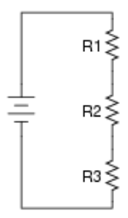
Intro to Series and Parallel Circuits
Let’s practice now! R1 = 20 Ω, R2 = 100 Ω, R3 = 50 Ω In Series
Notes:
Series Total Resistance = 20 + 100 + 50

Slide 6
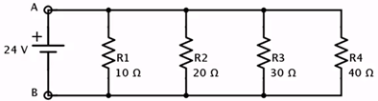

Intro to Series and Parallel Circuits
Let’s practice now! In parallel
Notes:
Parallel
Total Resistance must be less than smallest resistance, Total Resistance < 10 ohms
Total Resistance = 1/(1/10 + 1/20 + 1/30 + 1/40)

Slide 7
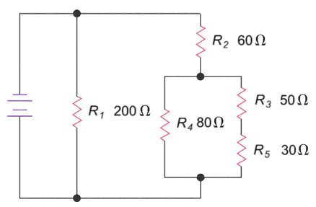
Total Resistance
youtube
Notes:
Show youtube video https://www.youtube.com/watch?v=v1a629-Ryjc

Slide 8
Total Resistance
Let’s practice now!
Notes:
66.67 ohms
Also do #3 on Practice Total Resistance, change kΩ to Ω

Slide 9
More?
Crash Course Physics
Series & Parallel Circuit Analysis

Slide 10
Review
Total Resistance in Series and Parallel Circuits

Slide 11
To Do:
Literal Equations Quiz
Total Resistance Quiz
Skill Review Quiz
Crash Course 07
Crash Course 08

Slide 12
Have a great day!
And remember that every day
at CVTC is a great day!

